Slide 1





eCommerce Website
Documentation
using Next.js
Group 1:
HABTAMU AYENEW FEKADU | WOUR/1200/13
DANIEL TADESSE BEKELE | WOUR/0693/13
ETSUBDINK GASHAW MEQUANNT | WOUR/4067/13
EYERUS TESFAYE GEBREMESKEL | WOUR/0964/13
Oct-2024 G.C

Slide 2
Agenda
Introduction
01
Explain the need for an eCommerce platform.
Mention the technologies used (Next.js, TypeScript, etc.).
•Project Objectives
02
Build a scalable, secure, and user-friendly eCommerce platform.
Use Next.js for server-side rendering and performance optimization.
Implement modular architecture for easier maintenance.
Feasibility
03
•Technical Feasibility
Operational Feasibility
Project Scope and Limitation
04
Highlight the boundaries of the project
which are outside the scope

Slide 3
Agenda
05
Existing System vs. New System
06
Key Diagrams (Use Cases, Architecture)
07
•Proposed Design and Security
08
•Conclusion

Slide 4
01
Introduction
Background:
E-commerce is a rapidly growing industry in Ethiopia,
The Ethiopian e-commerce market has significant potential for growth, driven by the increasing internet and smartphone penetration, as well as the rising middle-class population.
However, the existing e-commerce solutions in the country often suffer from slow loading times, poor user experience, and limited customization options.

Slide 5

What is Next.js
is a popular open-source React framework that was developed by Vercel (formerly Zeit).
However, the existing e-commerce solutions in the country often suffer from slow loading times, poor user experience, and limited customization options.
provides server-side rendering (SSR), static site generation (SSG), and code-splitting, making it an attractive choice for building modern web applications.

Slide 6
Project Objectives
Build a
scalable,
secure, and
user-friendly eCommerce platform.
Use Next.js for server-side rendering and performance optimization.
Implement modular architecture for easier maintenance.

Slide 7
Feasibility
Economic Feasibility
Schedule Feasibility
Market Potential
Cost Structure
Financial Projections
Project Scope
Resource Allocation
Contingency Planning
Technical Feasibility
Political Feasibility
Technology Stack
Development Expertise
Integration
Stakeholder Alignment
Regulatory Compliance
Feasibility
Operational Feasibility
Business Processes
Resource Availability
Risk Management

Slide 8
Project Scope
SCOPE
Target Market
Identify the primary customer segments and their geographic location(s) that the website will serve
Product/Service Offerings:
Determine the specific products or services that will be available for purchase through the e-commerce platform.
Key Features and Functionalities:
product catalogs shopping carts check out processes, payment gateways, and user accounts.
Security and Compliance:
data privacy regulations, payment industry standards,

Slide 9
Limitations
Complex State Management: Next.js doesn’t provide built-in state management, so external libraries like Redux or Context API are required
Limited Plugins and E-commerce Integrations:Determine the available
budget and the team's capacity in terms of expertise, and equipment to deliver the project
Server-Side Rendering Overhead:introduce additional complexity and overhead, especially with dynamic content like frequently updated product listings
Lack of Built-in E-commerce Features:it doesn’t have out-of-the-box features like product management, payment gateways
Scaling Issues with Static Generation:Static site generation (SSG) can be slow or challenging to scale with large catalogs.

Slide 10

Existing System VS Proposed
Existing System
Lack of scalability,
poor user experience,
outdated technology stack.
In the current landscape of e-commerce, there are numerous platforms that allow users to buy and sell products online. Many existing e-commerce systems are either too complex for small businesses or too rigid in their structure, limiting customization and scalability. Smaller vendors may find it challenging to establish an online presence due to the complexity of managing large-scale e-commerce systems, high fees, or the lack of technical support tailored to their needs.
Proposed e-commerce website
Developed using Next.js, aims to address the shortcomings of existing systems by providing a flexible, scalable, and user-friendly platform. The website leverages modern web technologies to offer a seamless experience for both administrators and users, ensuring that small businesses and individual sellers can efficiently manage their online stores without compromising on quality or functionality.
Real-time product updates.
Secure transactions.
Responsive UI with Tailwind CSS

Slide 11
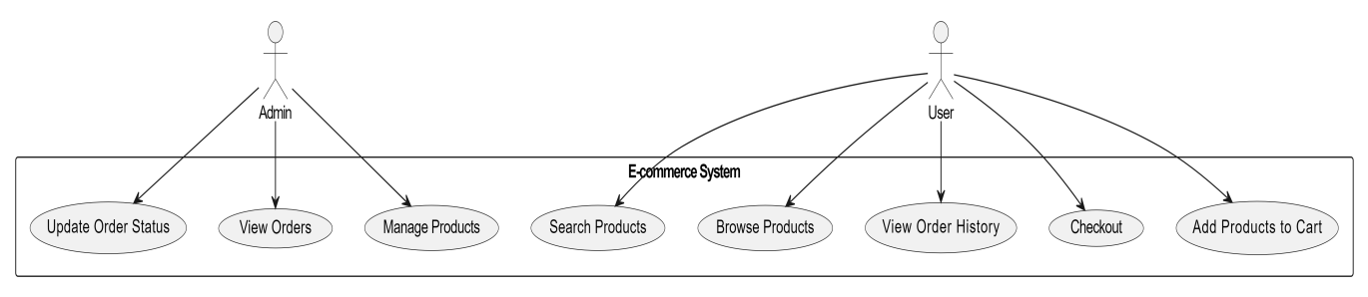
Esential System Use Case
Diagram
You can simply impress your audience an add a unique and appeal to your Reports and Presentations with our Templates. Get a modern PowerPoint Presentation that is beautifully designed. I hope and I believe that this Template will your Time, Money and Reputation.
Simple PowerPoint

Slide 12
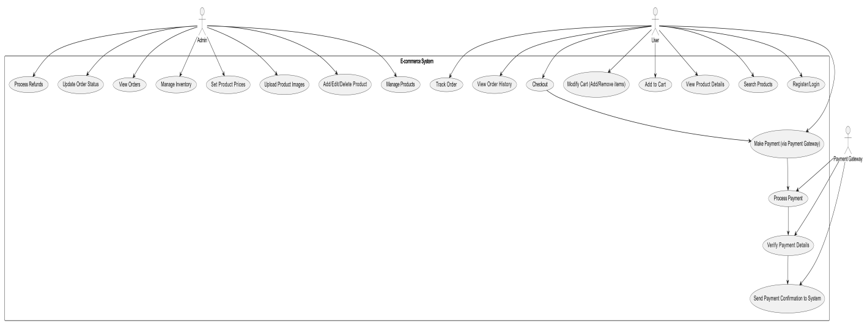
System Use Case
Diagram
You can simply impress your audience and add a unique and appeal to your Reports and Presentations with our Templates. Get a modern PowerPoint Presentation that is beautifully designed. I hope and I believe that this Template will your Time, Money and Reputation.
Simple PowerPoint

Slide 13
Subsystem Decomposition
User Management Sub-system
 | Resp: Handles user registration, authentication, profile management, and authorization. components:▪Auth Service, User Profile Service, Session Management
Product Management Subsystem
 | Resp: Manages the product catalog, including product creation, updates, categorization, and inventory management. components:Product Service, Service,Inventory Service.

Slide 14
Subsystem Decomposition
Order Management Subsystem
 | Resp: Handles the entire order lifecycle, from cart management to order placement, payment processing, and order tracking.. components:Cart Service: Order Service: Payment Service: Shipping Service:
Payment Gateway Integration Subsystem
 | Resp:Facilitates secure payment processing and integration with third-party payment services. components:Payment Processing Payment Verification Refund Management:

Slide 15
Subsystem Decomposition
Content Management Subsystem
 | Resp: Manages static and dynamic content across the platform, including banners, promotions, and blog posts. Components:CMS Service Media Management SEO Optimization
Analytics and Reporting Subsystem
 | Resp:Collects, analyzes, and reports data related to user behavior, sales, and system performance. components:Analytics Service Reporting Service Monitoring Service

Slide 16
Subsystem Decomposition
API Gateway
 | Resp: Serves as a single entry point for all client requests, routing them to the appropriate backend services. Components:Request Routing(DirectsI requests to the correct service), Security, Load Balancing

Slide 17
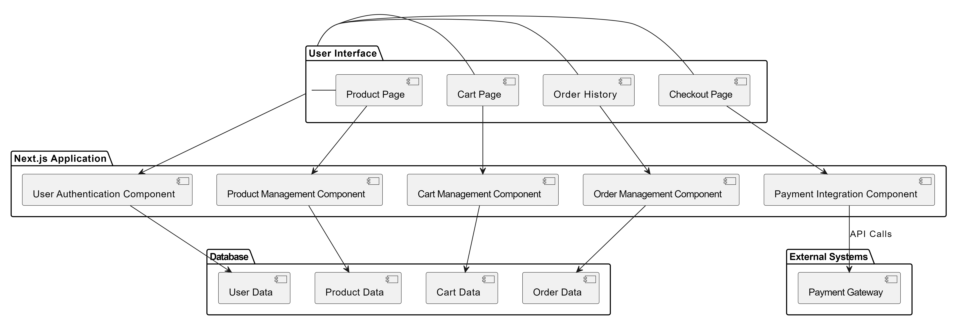
Component Diagram
provides a high-level view of the system architecture by illustrating the main software components and their interactions within the e-commerce platform.

Slide 18
Access Control and Security
Insert the title of your subtitle Here
are critical components of the e-commerce platform, ensuring that users can only access resources they are authorized to interact with and protecting sensitive information from unauthorized access or breaches.
Authentication
(username/password)
Authorization
Role-based(Admin, User)
Vulnerability Management
(penetration testing and code reviews)
Audit Logging(logs of all significant actions)

Slide 19
Thank you

